Slide 1


Slide 2
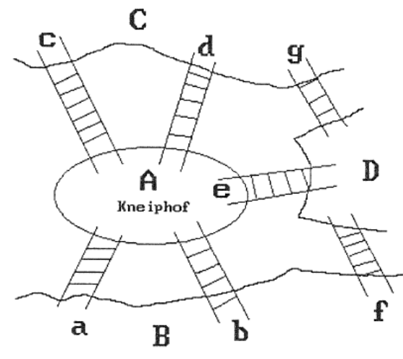
Introduction
Euler used graph theory to solve Seven Bridges of Königsberg problem.
Is there a possible way to traverse every bridge exactly once – Euler Tour
C
g
c
d
A
e
D
a
b
B
f

Slide 3
Definitions
A graph G=(V,E), V and E are two sets
  V: finite non-empty set of vertices
  E: set of pairs of vertices, edges
Undirected graph
  The pair of vertices representing any edge is unordered. Thus, the pairs (u,v) and (v,u) represent the same edge
Directed graph
  each edge is represented by a ordered pairs <u,v>

Slide 4
Examples of Graph G₁
G₁
  V(G1)={0,1,2,3}
  E(G1)={(0,1),(0,2), (0,3),(1,2),(1,3), (2,3)}
0
1
2
3

Slide 5
Examples of Graph G₂
G₂
  V(G2)={0,1,2,3,4,5,6}
  E(G2)={(0,1),(0,2), (1,3),(1,4),(2,5),(2,6)}
G₂ is also a tree
  Tree is a special case of graph
0
1
2
3
4
5
6

Slide 6
Examples of Graph G₃
G₃
  V(G3)={0,1,2}
  E(G3)={<0,1>,<1,0>,<1,2>}
Directed graph (digraph)
0
1
2

Slide 7
Examples of Graphlike Structures
Graph with self loops
Multigraph
0
0
2
1
3
1
2

Slide 8
Complete Graph
A Complete Graph is a graph that has the maximum number of edges
  For undirected graph with n vertices, the maximum number of edges is n(n-1)/2
  For directed graph with n vertices, the maximum number of edges is n(n-1)
Example: G₁

Slide 9
Adjacent and Incident
If (u,v) is an edge in an undirected graph,
  Adjacent: u and v are adjacent
  Incident: The edge (u,v) is incident on vertices u and v
If <u,v> is an edge in a directed graph
  Adjacent: u is adjacent to v, and vu is adjacent from v
  Incident: The edge <u,v> is incident on u and v

Slide 10
Subgraph
A subgraph of G is a graph G’ such that
  V(G’) ⊆ V(G)
  E(G’) ⊆ E(G)
Some of the subgraph of G₁
0
0
0
1
2
1
2
1
2
0
1
2
3
3
3
(i) (ii) (iii) (iv)
G₁

Slide 11
Subgraph
Some of the subgraphsof G₃
0
0
0
0
1
1
1
0
1
2
2
2
(i) (ii) (iii) (iv)
G3

Slide 12
Path
Path from u to v in G
  a sequence of vertices u, i₁, i₂,...,i_{k}, v
  If G is undirected: (u,i₁), (i₁,i₂),..., (i_{k},v)∈E(G)
  If G is directed: <u,i₁>,<i₁,i₂>,...,<i_{k},v>∈E(G)
Length
  The length of a path is the number of edges on it.
  Length of 0,1,3,2 is 3
0
1
2
3

Slide 13
Simple Path
Simple Path
  is a path in which all vertices except possibly the first and last are distinct.
0,1,3,2 is simple path
0,1,3,1 is path but not simple
0
1
2
3

Slide 14
Cycle
Cycle
  a simple path, first and last vertices are same.
0,1,2,0 is a cycle
Acyclic graph
  No cycle is in graph
0
1
2
3

Slide 15
Connected
Connected
  Two vertices u and v are connected if in an undirected graph G, ∃ a path in G from u to v.
  A graph G is connected, if any vertex pair u,v is connected
Connected Component
  a maximal connected subgraph.
Tree is a connected acyclic graph
1
2
3
4
connected
connected

Slide 16
Strongly Connected
Strongly Connected
  u, v are strongly connected if in a directed graph (digraph) G, ∃ a path in G from u to v.
  A directed graph G is strongly connected, if any vertex pair u,v is connected
Strongly Connected Component
  a maximal strongly connected subgraph
1
2
G₃
3
1
3
2

Slide 17
Degree
Degree of Vertex
  is the number of edges incident to that vertex
Degree in directed graph
  Indegree
  Outdegree
Summation of all vertices’ degrees are 2|E|

Slide 18
Graph Representations
Adjacency Matrix
Adjacency Lists
Adjacency Multilists
Weighted Edge

Slide 19
Graph Representations
undirected graph
directed graph
degree
in-degree
out-degree
3
0
0
in:1, out: 1
0
2
1
2
3
1
2
3
1
in: 1, out: 2
3
3
3
3
4
5
6
3
G1
1
1
2
in: 1, out: 0
1
G2
1

Slide 20
Graph Representations
ADT for Graph
structure Graph is
objects: a nonempty set of vertices and a set of undirected edges, where each edge is a pair of vertices
functions: for all graph ∈ Graph, v, v₁ and v₂ ∈ Vertices
Graph Create()::=return an empty graph
Graph InsertVertex(graph, v)::= return a graph with v inserted. v has no
incident edge.
Graph InsertEdge(graph, v1,v2)::= return a graph with new edge
between v1 and v2
Graph DeleteVertex(graph, v)::= return a graph in which v and all edges
incident to it are removed
Graph DeleteEdge(graph, v1, v2)::=return a graph in which the edge (v1, v2)
is removed
Boolean IsEmpty(graph)::= if (graph==empty graph) return TRUE
else return FALSE
List Adjacent(graph,v)::= return a list of all vertices that are adjacent to v

Slide 21
Graph Representations
Adjacency Matrix
Adjacency Lists
Adjacency Multilists

Slide 22
Adjacency Matrix
Adjacency Matrix : let G = (V, E) with n vertices, n ≥ 1. The adjacency matrix of G is a 2-dimensional n × n matrix, A
  A(i, j) = 1 iff (v_{i}, v_{j}) ∈E(G)
  (⟨v_{i}, v_{j}⟩ for a diagraph)
  A(i, j) = 0 otherwise.
The adjacency matrix for an undirected graph is symmetric; the adjacency matrix for a digraph need not be symmetric

Slide 23
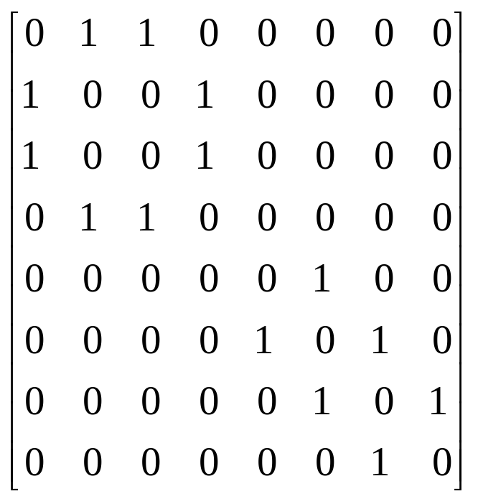
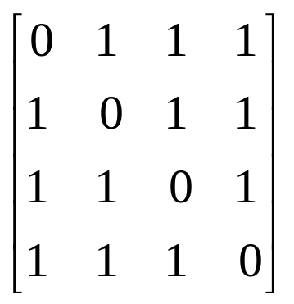
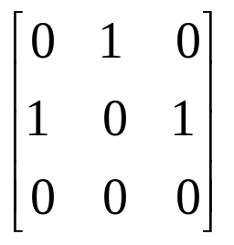
Example
0
4
2
1
5
0
3
6
0
1
2
7
3
1
2
G2
G1
symmetric
undirected: n²/2
directed: n²
G4

Slide 24
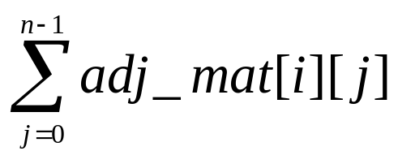
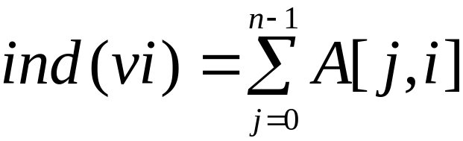
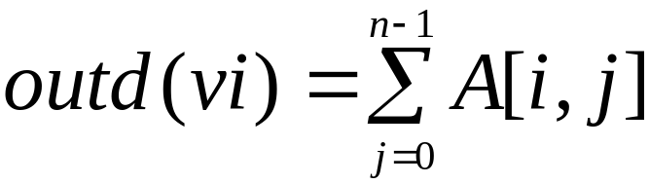
Merits of Adjacency Matrix
From the adjacency matrix, to determine the connection of vertices is easy
The degree of a vertex is
For a digraph, the row sum is the out_degree, while the column sum is the in_degree

Slide 25
Adjacency Lists
Replace n rows of the adjacency matrix with n linked list

Slide 26
Data Structures for Adjacency Lists
Each row in adjacency matrix is represented as an adjacency list.
#define MAX_VERTICES 50
typedef struct node *node_pointer;
typedef struct node {
int vertex;
struct node *link;
};
node_pointer graph[MAX_VERTICES];
int n=0; /* vertices currently in use */

Slide 27
Example(1)
0
0
1
2
1
3
0
1
2
3
2
1
2
3
0
2
3
0
1
2
1
0
1
3
0
2
0
1
2
G1
G3

Slide 28
Example(2)
0
1
2
3
4
5
6
7
1
2
0
4
0
3
2
1
5
0
3
1
2
3
6
5
4
6
7
5
7
6
G4
An undirected graph with n vertices and e edges ==> n head nodes and 2e list nodes

Slide 29
Interesting Operations
degree of a vertex in an undirected graph
  # of nodes in adjacency list
# of edges in a graph
  determined in O(n+e)
out-degree of a vertex in a directed graph
  # of nodes in its adjacency list
in-degree of a vertex in a directed graph
  traverse the whole data structure

Slide 30
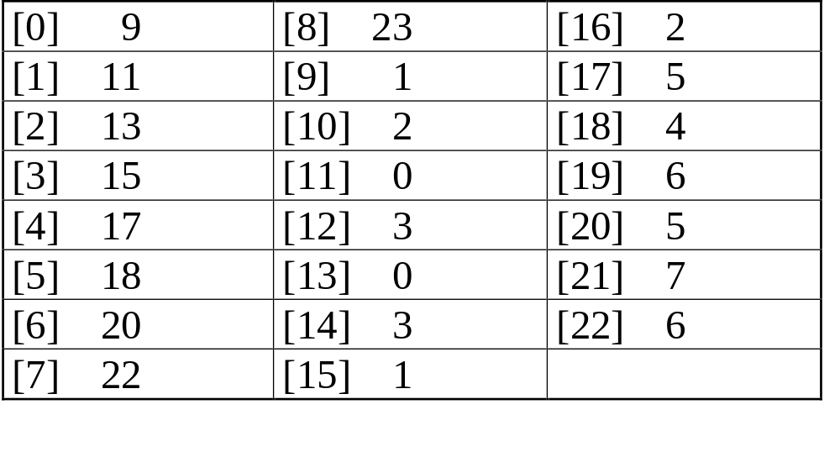
Compact Representation
0
4
node[0] … node[n-1]: starting point for vertices
node[n]: n+2e+1
node[n+1] … node[n+2e]: head node of edge
2
1
5
3
6
7
0
4
5
1
6
2
7
3

Slide 31
Adjacency Multilists
An edge in an undirected graph is represented by two nodes in adjacency list representation.
Adjacency Multilists
  lists in which nodes may be shared among several lists.
  (an edge is shared by two different paths)
marked vertex1 vertex2 path1 path2

Slide 32
Example for Adjacency Multlists
Lists: vertex 0: M1->M2->M3, vertex 1: M1->M4->M5
vertex 2: M2->M4->M6, vertex 3: M3->M5->M6
(1,0)
0
1
2
3
N1
N2
N3
N4
N5
N6
0 1 N2 N4
edge (0,1)
edge (0,2)
edge (0,3)
edge (1,2)
edge (1,3)
edge (2,3)
(2,0)
0 2 N3 N4
(3,0)
0 3 N5
(2,1)
1 2 N5 N6
0
(3,1)
1 3 N6
1
2
(3,2)
2 3
3
six edges

Slide 33
Data Structures for Adjacency Multilists
typedef struct edge *edge_pointer;
typedef struct edge {
short int marked;
int vertex1, vertex2;
edge_pointer path1, path2;
};
edge_pointer graph[MAX_VERTICES];
marked vertex1 vertex2 path1 path2

Slide 34
Some Graph Operations
Traversal
Given G=(V,E) and vertex v, find all w∈V,
such that w connects v.
  Depth First Search (DFS)
  preorder tree traversal
  Breadth First Search (BFS)
  level order tree traversal
Connected Components
Spanning Trees

Slide 35
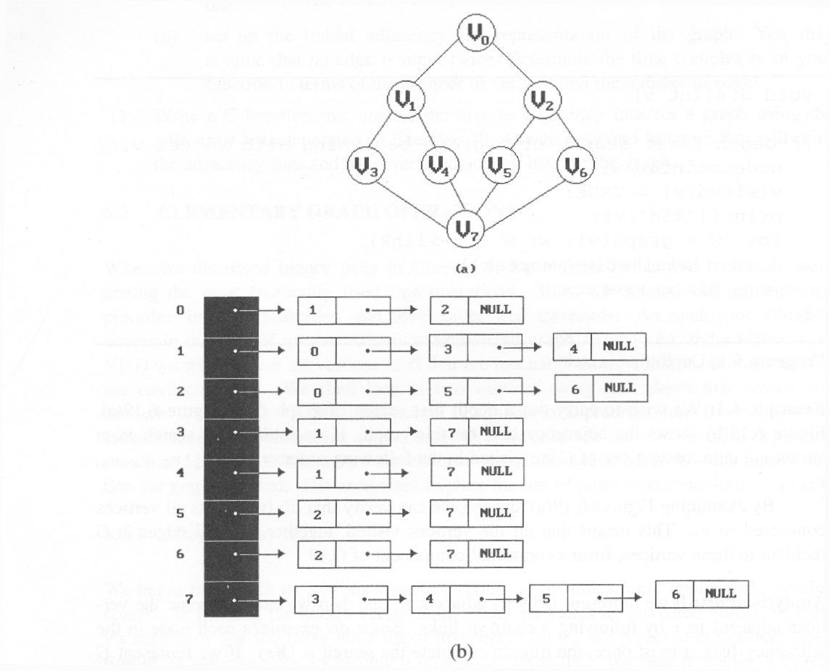
*Figure 6.19:Graph G and its adjacency lists (p.274)
depth first search: v0, v1, v3, v7, v4, v5, v2, v6
breadth first search: v0, v1, v2, v3, v4, v5, v6, v7

Slide 36
Weighted Edge
In many applications, the edges of a graph are assigned weights
These weights may represent the distance from one vertex to another
A graph with weighted edges is called a network

Slide 37
Elementary Graph Operations
Traversal: given G = (V,E) and vertex v, find or visit all w∈V, such that w connects v
  Depth First Search (DFS)
  Breadth First Search (BFS)
Applications
  Connected component
  Spanning trees
  Biconnected component

Slide 38
Depth First Search
Begin the search by visiting the start vertex v
  If v has an unvisited neighbor, traverse it recursively
  Otherwise, backtrack
Time complexity
  Adjacency list: O(|E|)
  Adjacency matrix: O(|V|²)

Slide 39
Example
Start vertex: 0
Traverse order: 0, 1, 3, 7, 4, 5, 2, 6
0
1
2
3
4
5
6
7

Slide 40
Depth First Search
#define FALSE 0
#define TRUE 1
short int visited[MAX_VERTICES];
void dfs(int v)
{
node_pointer w;
visited[v]= TRUE;
printf(“%5d”, v);
for (w=graph[v]; w; w=w->link)
if (!visited[w->vertex])
dfs(w->vertex);
}
Data structure
adjacency list: O(e)
adjacency matrix: O(n²)

Slide 41
Breadth First Search
Begin the search by visiting the start vertex v
  Traverse v’s neighbors
  Traverse v’s neighbors’ neighbors
Time complexity
  Adjacency list: O(|E|)
  Adjacency matrix: O(|V|²)

Slide 42
Example
Start vertex: 0
Traverse order: 0, 1, 2, 3, 4, 5, 6, 7
0
1
2
3
4
5
6
7

Slide 43
Breadth First Search
typedef struct queue *queue_pointer;
typedef struct queue {
int vertex;
queue_pointer link;
};
void addq(queue_pointer *,
queue_pointer *, int);
int deleteq(queue_pointer *);

Slide 44
Breadth First Search (Continued)
void bfs(int v)
{
node_pointer w;
queue_pointer front, rear;
front = rear = NULL;
printf(“%5d”, v);
visited[v] = TRUE;
addq(&front, &rear, v);

Slide 45
Breadth First Search (Continued)
while (front) {
v= deleteq(&front);
for (w=graph[v]; w; w=w->link)
if (!visited[w->vertex]) {
printf(“%5d”, w->vertex);
addq(&front, &rear, w->vertex);
visited[w->vertex] = TRUE;
}
}
}

Slide 46
Connected Component
Find all connected component in a graph G
Select one unvisited vertex v, and start DFS (or BFS) on v
Select one another unvisited vertex v, and start DFS (or BFS) on v

Slide 47
Example
Start on 0
  0, 1, 3, 4, 7 is visited
  These 5 vertices is in the
  same connected
  component
Choose 2
  2, 5, 6 is visited
0
1
2
3
4
5
6
7

Slide 48
Connected Component
void connected(void)
{
for (i=0; i<n; i++) {
if (!visited[i]) {
dfs(i);
printf(“\n”);
}
}
}

Slide 49
Other Applications
Find articulation point (cut vertex) in undirected connected graph
Find bridge (cut edge) in undirected connected graph
Find strongly connected component in digraph
Find biconnected connected component in connected graph
Find Euler path in undirected connected graph
Determine whether a graph G is bipartite graph?
Determine whether a graph G contain cycle?
Calculate the radius and diameter of a tree

Slide 50
Spanning Trees
Spanning tree: any tree consisting only edges in G and including all vertices in G is called.
Example:
How many spanning trees?

Slide 51
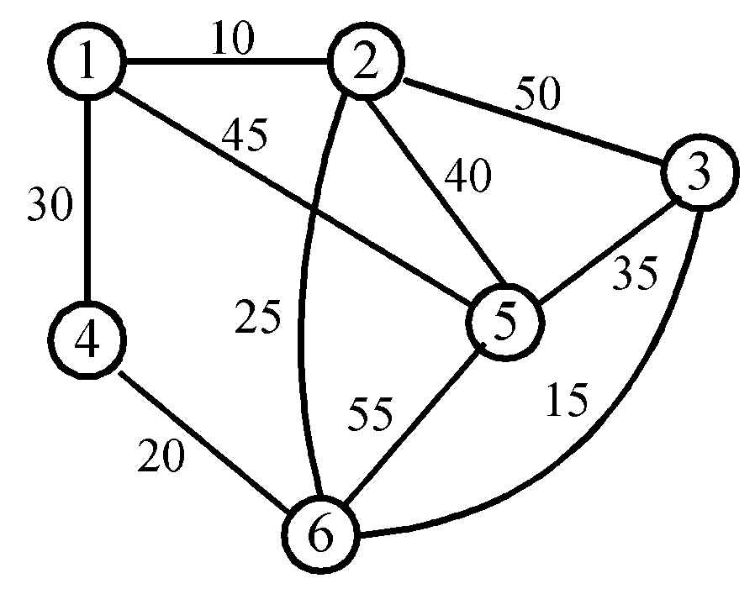
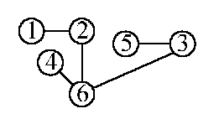
Example

Slide 52
Spanning Trees
Either dfs or bfs can be used to create a
spanning tree
  When dfs is used, the resulting spanning tree is
  known as a depth first spanning tree
  When bfs is used, the resulting spanning tree is
  known as a breadth first spanning tree
While adding a nontree edge into any spanning
tree, this will create a cycle

Slide 53
DFS VS BFS Spanning Tree
0
0
0
1
2
1
2
1
2
3
4
5
6
3
4
5
6
3
4
5
6
7
7
nontree edge
cycle
7
DFS Spanning
BFS Spanning

Slide 54
Spanning Trees
A spanning tree is a minimal subgraph, G’, of G
such that V(G’)=V(G) and G’ is connected.
Any connected graph with n vertices must have
at least n-1 edges.
A biconnected graph is a connected graph that has
no articulation points.
0
1
2
biconnected graph
3
4
5
6
7

Slide 55
Spanning Trees
two connected components
connected graph
one connected graph
8
9
0
8
9
8 9
0
0
2
2
7
1
7
7
1
1
5
2
3
5
2
3
5
3
4
4
6
4
6
6

Slide 56
Spanning Trees
biconnected component: a maximal connected subgraph H
(no subgraph that is both biconnected and properly contains H)
0
8
9
0
8 9
1
7
7
2
7
1
2
7
1
3
5
3
3
5
5
4
6
4
6
biconnected components

Slide 57
Spanning Trees
nontree
edge
(back edge)
Find biconnected component of a connected undirected graphby depth first spanning tree
0
4
3
0
9 8 9 8
1
5
nontree
edge
(back edge)
4
5
7 7
3
1
0 5
2
2
6
6
2
2
5
5
3
dfn
depth
first
number
1
7
7
8
9
4
6
4
0
9
8
1
6
Why is cross edge impossible?
(a) depth first spanning tree (b)
If u is an ancestor of v then dfn(u) < dfn(v).

Slide 58
Spanning Trees
3
*The root of a depth first spanning
tree is an articulation point iff
it has at least two children.
1 5
4
5
2
6
7
6
*Any other vertex u is an articulation
point iff it has at least one child w
such that we cannot reach an ancestor
of u using a path that consists of
(1) only w (2) descendants of w (3)
single back edge.
2
4
3
1
7
8 9
0
9
8
low(u)=min{dfn(u),
min{low(w)|w is a child of u},
min{dfn(w)|(u,w) is a back edge}
u: articulation point
low(child) ≥ dfn(u)

Slide 59
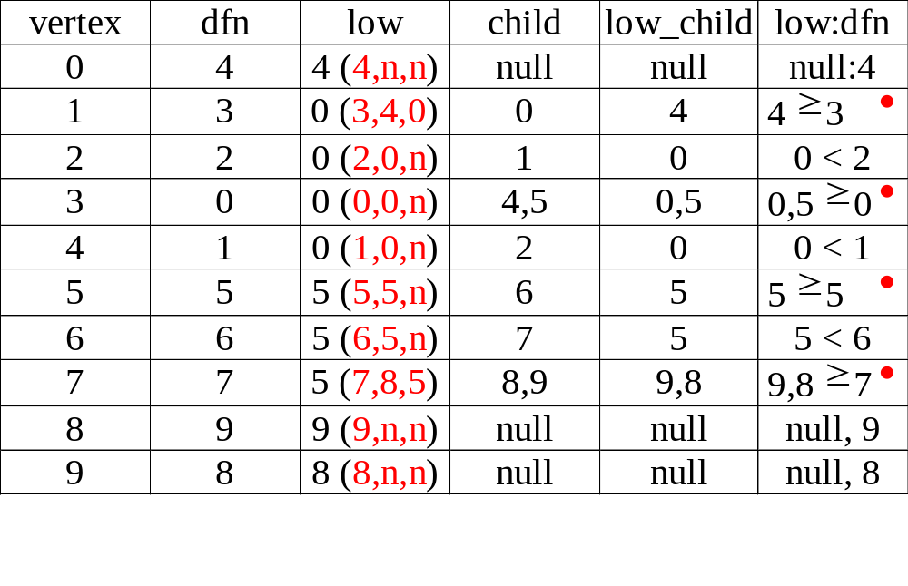
Spanning Trees
3
1 5
4
5
2
4
2
6
7
6
3
1
7
8 9
0
9
8

Slide 60
Initializaiton of dfn and low
void init(void)
{
int i;
for (i = 0; i < n; i++) {
visited[i] = FALSE;
dfn[i] = low[i] = -1;
}
num = 0;
}

Slide 61
Determining dfn and low
void dfnlow(int u, int v)
{
node_pointer ptr;
int w;
dfn[u] = low[u] = num++;
for (ptr = graph[u]; ptr; ptr = ptr ->link) {
w = ptr ->vertex;
if (dfn[w] < 0) {
/*w is an unvisited vertex */
dfnlow(w, u);
low[u] = MIN2(low[u], low[w]);
}
else if (w != v)
low[u] =MIN2(low[u], dfn[w] ); }}

Slide 62
Biconnected components of a graph
void bicon(int u, int v)
{
node_pointer ptr;
int w, x, y;
dfn[u] = low[u] = num ++;
for (ptr = graph[u]; ptr; ptr = ptr->link) {
w = ptr ->vertex;
if ( v != w && dfn[w] < dfn[u] )
add(&top, u, w);
if(dfn[w] < 0) {
bicon(w, u);
low[u] = MIN2(low[u], low[w]);

Slide 63
Biconnected components of a graph (con.)
if (low[w] >= dfn[u] ){ articulation point
printf(“New biconnected component: “);
do { /* delete edge from stack */
delete(&top, &x, &y);
printf(“ <%d, %d>” , x, y);
} while (!(( x = = u) && (y = = w)));
printf(“\n”);
}
}
else if (w != v) low[u] = MIN2(low[u], dfn[w]);}}

Slide 64
Minimum Cost Spanning Tree
The cost of a spanning tree of a weighted undirected graph is the sum of the costs of the edges in the spanning tree
A minimum cost spanning tree is a spanning
tree of least cost
Three different algorithms can be used
  Kruskal
  Prim
  Sollin
Select n-1 edges from a weighted graph
of n vertices with minimum cost.

Slide 65
Greedy Strategy
An optimal solution is constructed in stages
At each stage, the best decision is made at this time
Since this decision cannot be changed later,
we make sure that the decision will result in a feasible solution
Typically, the selection of an item at each
stage is based on a least cost or a highest profit criterion

Slide 66
Kruskal’s algorithm for finding MST
Step 1: Sort all edges into nondecreasing order.
Step 2: Add the next smallest weight edge to the forest if it will not cause a cycle.
Step 3: Stop if n-1 edges. Otherwise, go to Step2.
Time complexity: O(|E| log |E|)

Slide 67
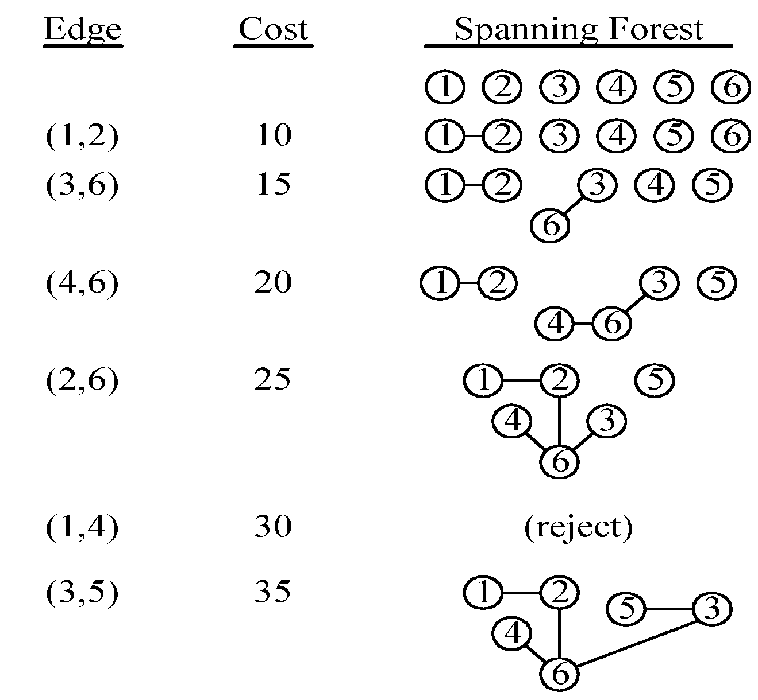
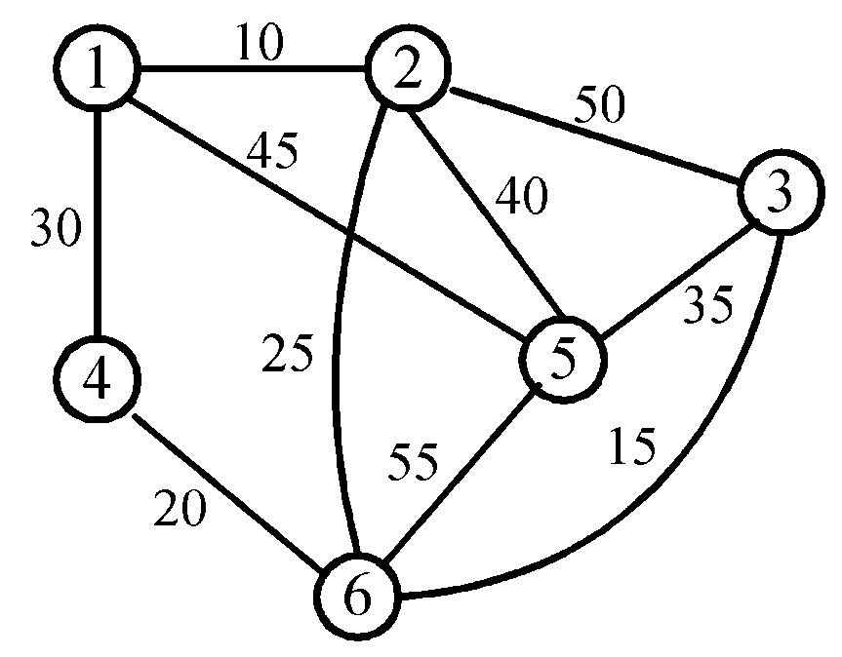
Example

Slide 68
Kruskal’s Algorithm
T= {};
while (T contains less than n-1 edges
&& E is not empty) {
choose a least cost edge (v,w) from E;
delete (v,w) from E;
if ((v,w) does not create a cycle in T)
add (v,w) to T
else discard (v,w);
}
if (T contains fewer than n-1 edges)
printf(“No spanning tree\n”);

Slide 69
Prim’s Algorithm
Step 1: x ∈ V, Let A = {x}, B = V - {x}.
Step 2: Select (u, v) ∈ E, u ∈ A, v ∈ B such that (u, v) has the smallest weight between A and B.
Step 3: Put (u, v) in the tree. A = A ∪ {v}, B = B - {v}
Step 4: If B = ∅, stop; otherwise, go to Step 2.
Time complexity : O(|V|²)

Slide 70
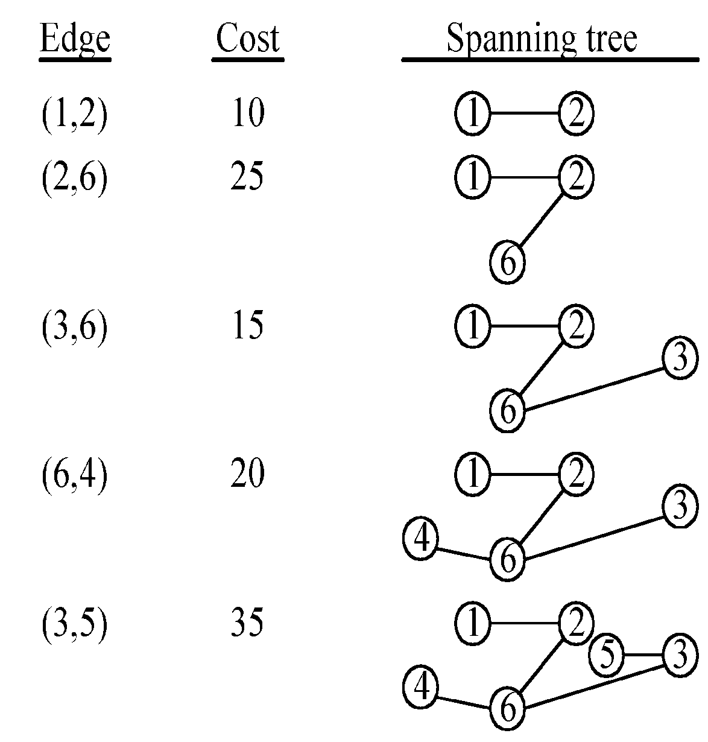
Example

Slide 71


Prim’s Algorithm
T={};
TV={0};
while (T contains fewer than n-1 edges)
{
let (u,v) be a least cost edge such
that and
if (there is no such edge ) break;
add v to TV;
add (u,v) to T;
}
if (T contains fewer than n-1 edges)
printf(“No spanning tree\n”);

Slide 72
Shortest Paths
Given a directed graph G=(V,E), a weighted function, w(e).
How to find the shortest path from u to v?

Slide 73
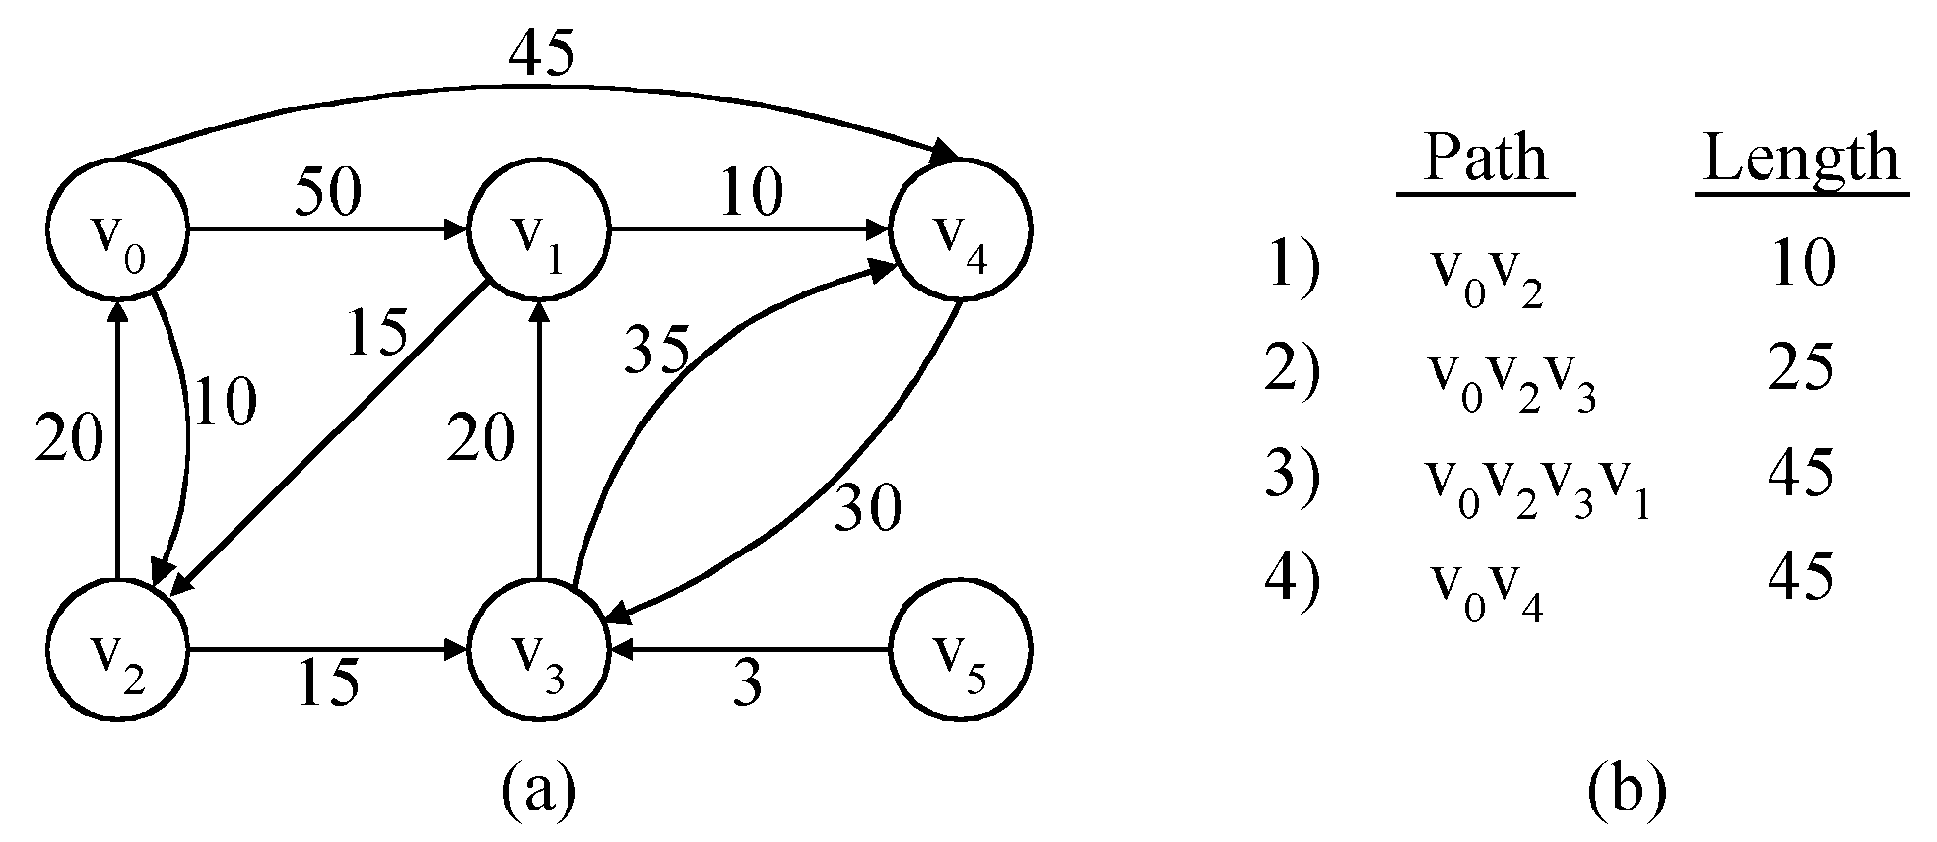
Example:
Graph and shortest paths from v₀
shortest paths from v₀ to all destinations

Slide 74
Shortest Paths
Single source all destinations:
  Nonnegative edge costs: Dijkstra’s algorithm
  General weights: Bellman-Ford’s algorithm
All pairs shortest path
  Floyd’s algorithm

Slide 75
Single Source All Destinations: Nonnegative Edge Costs
Given a directed graph G=(V,E), a weighted function, w(e), and a source vertex v₀
We wish to determine a shortest path from v₀ to each of the remaining vertices of G

Slide 76
Dijkstra’s algorithm
Let S denotes the set of vertices, including v₀, whose shortest paths have been found.
For w not in S, let distance[w] be the length of the shortest path starting from v₀, going through vertices only in S, and ending in w.
We can find a vertex u not in S and distance[u] is minimum, and add u into S.
Maintain distance properly
Complexity: (|V|²)

Slide 77
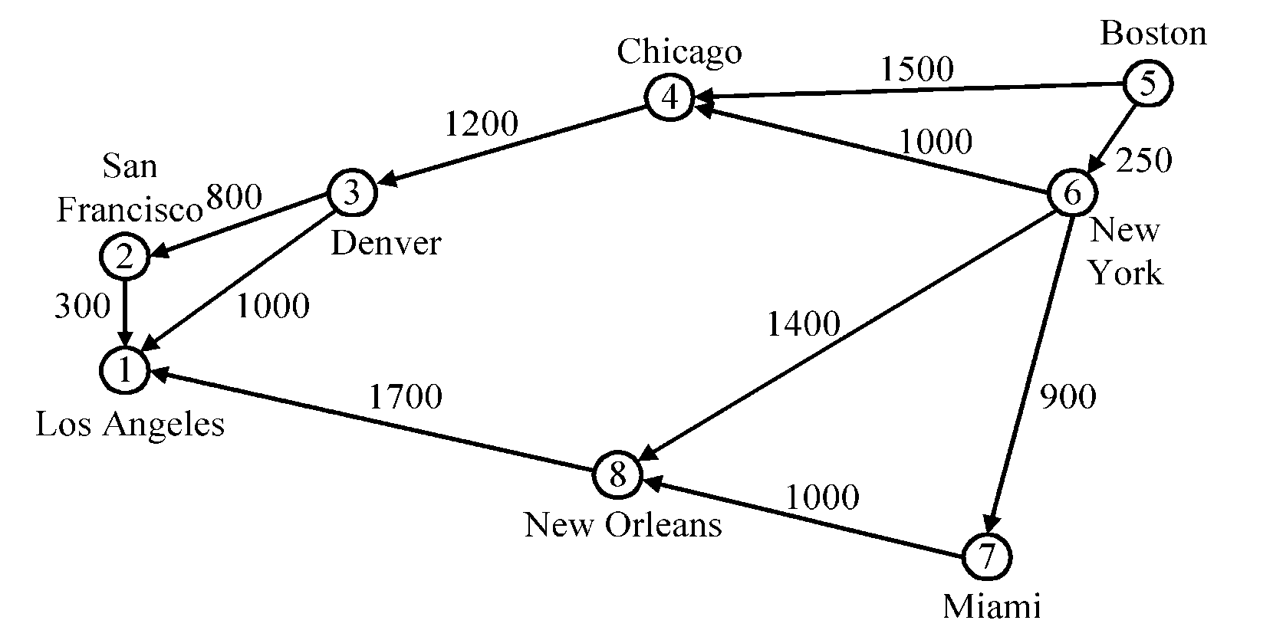
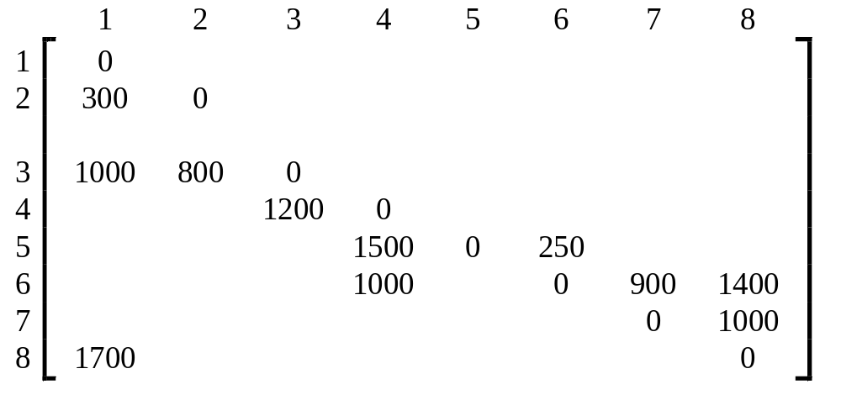
Dijkstra’s algorithm
Cost adjacency matrix. All entries not shown are +∞.

Slide 78

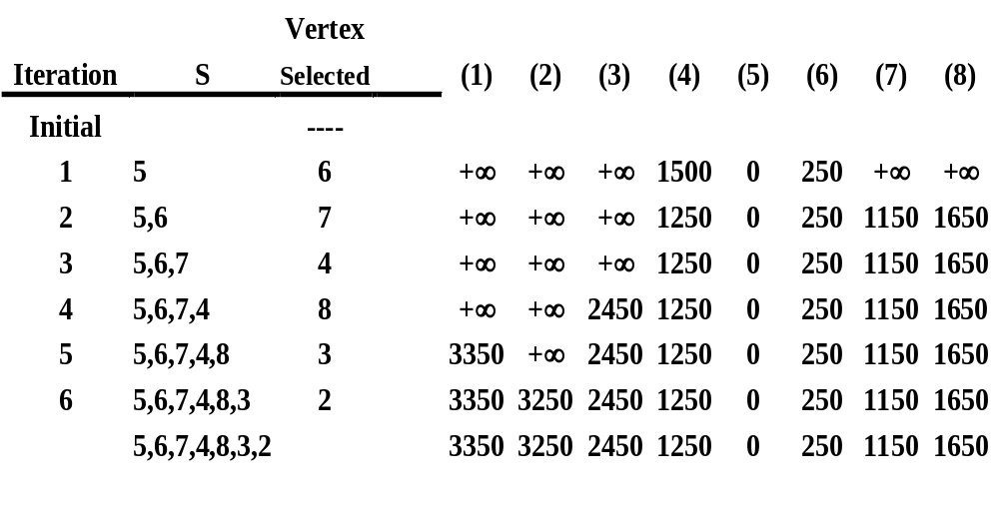

Slide 79
All Pairs Shortest Paths
Given a directed graph G=(V,E), a weighted function, w(e).
How to find every shortest path from u to v for all u,v in V?

Slide 80
Floyd’s Algorithm
Represent the graph G by its length adjacency matrix with length[i][j]
If the edge <i, j> is not in G, the Represent the graph G by its length adjacency matrix with length[i][j] is set to some sufficiently large number
A^{k}[i][j] is the Represent the graph G by its length adjacency matrix with length of the shortest path form i to j, using only those intermediate vertices with an index ≤ k
Complexity: O(|V|³)

Slide 81
A^{k}[i][j]
A⁻¹[i][j] = length[i][j]
A^{k}[i][j] = the length (or cost) of the shortest path from i to j going through
no intermediate vertex of index greater than k
= min{ A^{k-1}[i][j], A^{k-1}[i][k]+A^{k-1}[k][j] } k≧0

Slide 82
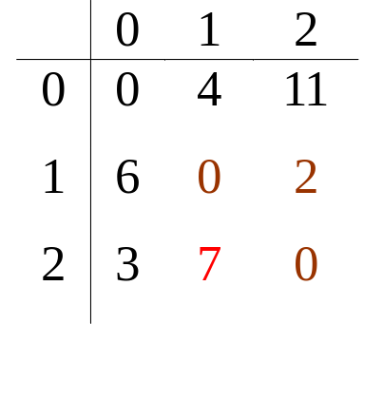
Example
6
A⁻¹
0
1
2
v₀
v₁
0
0
4
11
4
11
1
6
0
2
3
2
2
3
∞
0
v₂
6
v₀
v₁
A⁰
4
3
11
2
v₂

Slide 83
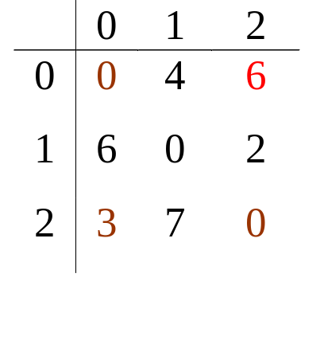
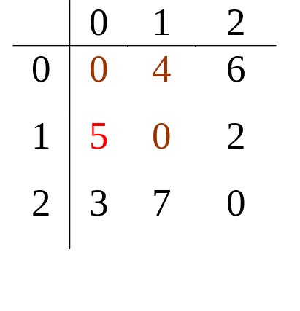
Example cont.
6
A¹
v₀
v₁
4
3
11
2
v₂
6
A²
v₀
v₁
4
3
11
2
v₂

Slide 84
Example
C3 is C1’s successor
C1 is C3’s predecessor
C8
C9
C1
C10
C11
C3
C7
C2
C12
C13
C14
C4
C5
C6
C15

Slide 85
Topological Ordering
A topological order is a linear ordering of the vertices of a graph such that, for any two vertices, i, j, if i is a predecessor of j in the network then I precedes j in the ordering

Slide 86
Example
C1 C2 C4 C5 C3 C6 C8 C7 C10 C13 C12 C14 C15 C11 C9
May not unique
C8
C9
C1
C10
C11
C3
C7
C2
C12
C13
C14
C4
C5
C6
C15

Slide 87
Topological Sort
Find a vertex v such that v has no predecessor, output it. Then delete it from network
Repeat this step until all vertices are deleted
Time complexity: O(|V| + |E|)

Slide 88
Example
v₀ has no predecessor, output it. Then delete it and three edges
v₁
v₁
v₀
v₂
v₄
v₀
v₂
v₄
v₃
v₅
v₃
v₅

Slide 89
Example cont.
Choose v₃, output it
Final result: v₀, v₃, v₂, v₁, v₄, v₅
v₁
v₂
v₄
v₃
v₅

Slide 90
Topological sort
for (i = 0; i <n; i++) {
if every vertex has a predecessor {
fprintf(stderr, “Network has a cycle.\n “ );
exit(1);
}
pick a vertex v that has no predecessors;
output v;
delete v and all edges leading out of v
from the network;
}

Slide 91
Issues in Data Structure Consideration
Decide whether a vertex has any predecessors.
  Each vertex has a count.
Decide a vertex together with all its incident edges.
  Adjacency list

Slide 92
Adjacency list representation
headnodes
node
count
link
vertex
link
V₀
V₁
V₂
0 •
1 •
2 •
3 NULL
1 •
4 NULL
1 •
4 •
5 NULL
V₃
V₄
V₅
1 •
5 •
4 NULL
v1
3 NULL
v0
v2
v4
2 NULL
v3
v5

Slide 93
typedef struct node *node_pointer;
typedef struct node {
int vertex;
node_pointer link;
};
typedef struct {
int count;
node_pointer link;
} hdnodes;
hdnodes graph[MAX_VERTICES];

Slide 94
Topological sort
void topsort (hdnodes graph [] , int n)
{
int i, j, k, top;
node_pointer ptr;
/* create a stack of vertices with no predecessors */
top = -1;
for (i = 0; i < n; i++)
if (!graph[i].count) {
graph[i].count = top; top = i;
}
for (i = 0; i < n; i++)
if (top == -1) {
fprintf(stderr, “\n Network has a cycle. Sort terminated. \n”);
exit(1);
}

Slide 95
Topological sort
else {
j = top; /* unstack a vertex */
top = graph[top].count;
printf(“v%d, “, j);
for (ptr = graph [j]. link; ptr ;ptr = ptr ->link ) {
/*decrease the count of the successor vertices of j*/
k = ptr ->vertex;
graph[k].count --;
if (!graph[k].count) {
/* add vertex k to the stack*/
graph[k].count = top;
top = k;
}
}
}
}

